Slide 1

******************************
Hotel Management System
By
Keshav Agrawal – 220962436 – 73
Kirtan Desai – 220962 – 72
Ankur Monga – 220962137 – 81
Ishan – 220962270 - 41
1

Slide 2


Introduction
In the dynamic and fast-paced hospitality industry, efficient management of a hotel's operations is essential to ensure exceptional guest experiences and smooth day-to-day functioning. Our Hotel Management System, built using JavaFX, is a comprehensive and user-friendly solution designed to streamline the management of hotels.

Slide 3
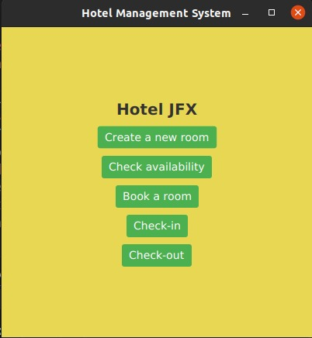
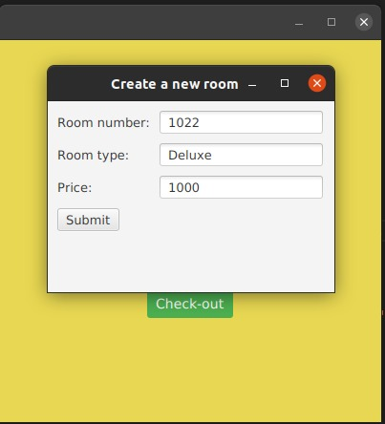
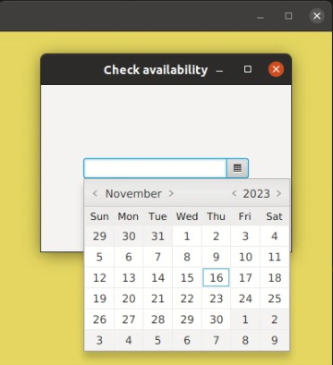
Results and Screenshots
Home Page Creating a new room Checking Availability

Slide 4
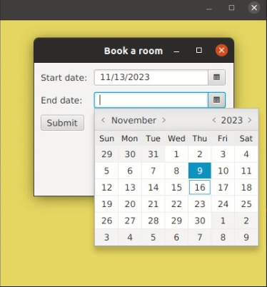
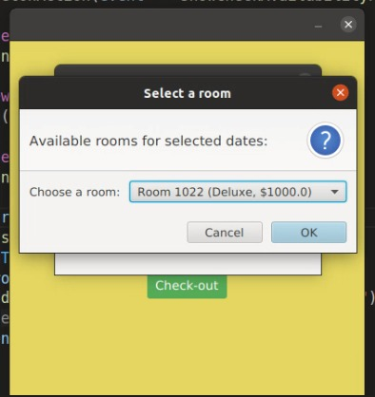
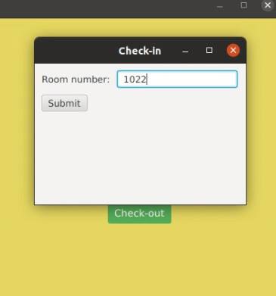
Results and Screenshots
Booking a room Selecting type of room Checking in Room

Slide 5
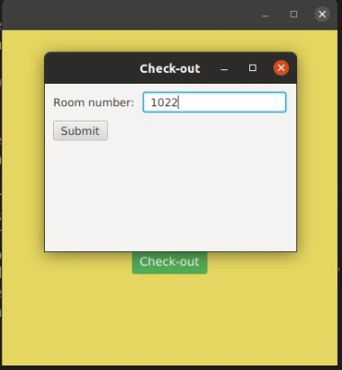
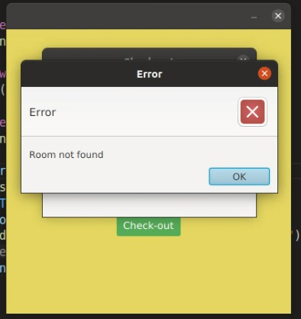
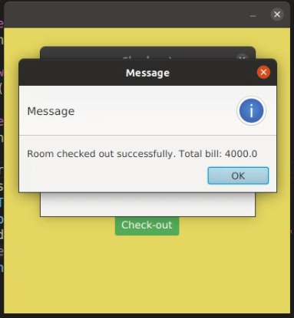
Results and Screenshots
Checking out of the room Error message if wrong input Successfully Checked out

Slide 6
Future Enhancements for Improved Functionality
01
02
03
Mobile App Integration
Real-Time Payment
Integrating Database
04
05
06
Feedback and Review
Multi-Language Support
Environmental Initiatives
Develop a mobile app for guest reservations and services, providing on-the-go convenience.
Implement a real time payment by integrating payment gateways
Integrating a robust database will enable the system to store guest information, reservations, and transactions efficiently.
Automate the collection and analysis of guest feedback for improved service quality.
Expand user reach by offering the system in various languages to accommodate international guests.
Promote sustainability with features that monitor and encourage eco-friendly practices in the hotel.

Slide 7
Conclusion
In summary , through its intuitive interface and customizable modules, the JavaFX Hotel Management System becomes an indispensable tool, fostering better communication between departments and facilitating data-driven decision-making. Its adaptability ensures it stays at the forefront of technological advancements, continuously supporting hotels in delivering exceptional guest experiences while optimizing internal processes. Furthermore, its potential for integration with emerging technologies positions it as a cornerstone for innovation within the hospitality industry.

Slide 8
Refrences
https://openjfx.io/openjfx-docs/ ​
Java The Complete Reference 11th edition, Herbert Schildt, McGraw Hill Publication ​
Ford, G.L. et al. (2022). Tactical Asset Management. In: Ancell, G., et al. Power System Assets. CIGRE Green Books Springer​.

Slide 9


Thank You!

